Slide 1
2024 FSC Local Rules

Slide 2
FSC rules include General rules, CV rules, EV rules and AV rules, among which general rules and CV rules are modified based on FSAE 2024, while EV and AV rules are based on FS rules. International teams participating in Chinese events need to design and manufacture according to Chinese rules, and submit relevant documents (SES, IAD, etc.) on time.
2024 FSC Local Rules

Slide 3
Changes in 2024 FSCC Rules(General&CV)

Slide 4
Catalog
Driver Equipment
General & Administrative
Document Requirements
Technical Aspects
Static Events
Dynamic Events
Hybrid System

Slide 5
1. Driver Equipment
1.1 Add：Limit of Fire resistant clothing
Fire resistant clothing must not be older than 10 years, recognisable since no FIA hologram label present.

Slide 6
2. General & Administrative
2.1 Add：Sensor covers’ install&remove requirement
Installing and removing protective sensor covers, if approved during technical inspection.
2.2 Add：General Penalties
Rule violations result in at least 20 penalty points, unless explicitly defined otherwise. The penalty points will be deducted from the team’s overall score.
Overall penalties apply to CV, EV and DC score, except for penalties concerning events which are not part of the respective class or cup.

Slide 7
3. Document Requirements
3.1 Add：Vehicle Status Video（VSV）requirements
All teams must submit a video showing the vehicle driving prior to the competition. The video must be submitted before the deadline specified in the competition handbook.
The video must show the following sequences in the described order:
  Standing still
  360◦ video around the vehicle (close up, may overlap with the following two bullet points)
  [EV ONLY] Activate TS
  [CV ONLY] Start engine
  Straight driving, minimum distance is 30 m, minimum speed is 10 km/h for vehicles with driver
  Full stop
  180° cornering
  Straight driving back to start point, minimum speed is 10 km/h for vehicles with driver
  Standing still

Slide 8
3. Document Requirements
3.1 Add：Vehicle Status Video（VSV）requirements
The video must fulfill the following criteria:
  Continuous video from a third person view - no assembled sequences
  Vehicle must be clearly visible (light, video resolution, frames and frequency)
  Vehicle must run under its own power
  Vehicle must be presented in ready-to-race conditions incl. body work
  No crossing in front of the vehicle after [EV ONLY] TS activated / [CV ONLY] engine started
  [EV ONLY] Tractive System Active Light (TSAL), and brake light, must be clearly visible in the video
  [EV ONLY] Ready-to-drive (R2D) sound must be audible in the video
  Must not exceed a length of 60 seconds. File size may be limited, see the competition handbook.
  File format must be common e.g. avi, mpg, mp4, wmv
If a team receives a “fail” for its video prior to the VSV deadline, the video will be treated as not submitted. A new submission is possible afterwards.
A team which uploads a VSV with a previous year vehicle will be de-registered from the competition.

Slide 9
4. Technical Aspects-Body
4.1 Del: Requirements of additional braces on main hoop
If there are any components outside the Primary Structure Envelope and are connected to the main hoop brace, then additional diagonal braces must be added to carry the bending loads on the main hoop brace when a rollover accident happened. The Primary Structure Envelope is a volume enclosed by multiple tangent planes, each of which follows the exact outline of the Primary Structure Frame Members.

Slide 10
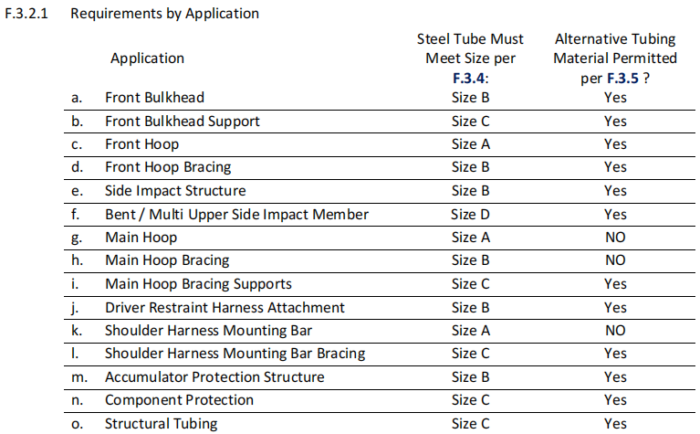
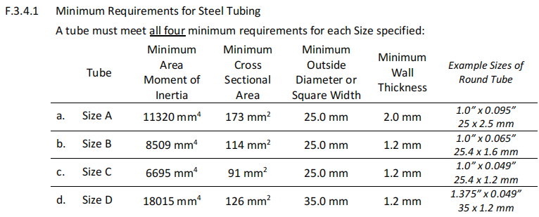
4. Technical Aspects-Body
4.2 Synchronized Tubing Requirements to FSAE Rules
FSAE_Rules_2024_V1 F3.2

Slide 11
4. Technical Aspects-Body
4.3 Add: Welded tubing reinforcements must be shown in the SES
Where Welded tubing reinforcements are required (such as inserts for bolt holes or material to support suspension cutouts), Equivalence of the Welded tube and reinforcement must be shown to the original Non Welded tube in the SES
4.4 Add: Alternative Materials statements in SES
If any Alternative Materials are used, the SES must contain:
  a. Documentation of material type, (purchase receipt, shipping document or letter of donation) and the material properties.
  b. Calculations that show equivalent to or better than the minimum requirements for steel tubing in the application as listed in F.3.4.1 for yield and ultimate strengths matching the Non Welded Steel properties from F.3.4.2.a above in bending, buckling and tension, for buckling modulus and for energy dissipation
  c. Details of the manufacturing technique and process

Slide 12
4. Technical Aspects——Body
4.5 Del: Titanium and Magnesium Tubing as Alternative Tubing
Titanium and Magnesium Tubing
  a. Minimum Wall Thickness for Titanium Tubing 1.2 mm
  b. Minimum Wall Thickness for Magnesium Tubing 3.0 mm
  c. Titanium or magnesium on which any welding has been utilized must not be used or any part of the Primary Structure
4.6 Add: Primary Structure Laminate Testing
d. Test panels must use the thickest core associated with each skin layup. Designs may use core thickness that is 50% - 100% of the test panel core thickness associated with each skin layup.
e. Calculation of derived properties must use the part of test data where deflection is 50 mm or less
f. Calculation of absorbed energy must use the integral of force times displacement.

Slide 13
4. Technical Aspects——Body
4.7 Modified: Tubes opening&ending requirements
2023 FSCC Rules
Chassis tubing must have any open ends closed by a welded cap or inserted metal plug.
2024 FSCC Rules
Regulated tubing other than the open lower ends of Roll Hoops must have any open ends closed by a welded cap or inserted metal plug.
4.8 Add：Technical Inspection Requirement of Front Hoop
A Front Hoop that is not steel must have a 4 mm hole drilled in a location to access during Technical Inspection.
4.9 Add：age and expiration date of bonded joint need to be shown in SES
Document the adhesive choice, age and expiration date, substrate preparation, and the equivalency of the bonded joint in the SES.

Slide 14
4. Technical Aspects——Body
4.10 Modified: Area of steering protection（Ch2-3.17）
2023 FSCC Rules
Steering system racks or mounting components that are external (above or below) to the Primary Structure must be protected from frontal impact. The protective structure must:
  a. Meet F.3.2.1.n or Equivalent
  b. Extend to the vertical limit of the steering component(s)
  c. Extend to the local width of the Chassis
2024 FSCC Rules
Steering system racks or mounting components that are external (vertically above or below) to the Primary Structure must be protected from frontal impact. The protective structure must:
  a. Meet F.3.2.1.n or Equivalent
  b. Extend to the vertical limit of the steering component(s)
  c. Extend to the local width of the Chassis

Slide 15
4. Technical Aspects——Body
4.11 Modified: （Ch2-3.17）
2023 FSCC Rules
The Lower Side Impact Structure member must connect the bottom of the Main Hoop and the
bottom of the Front Hoop.
The lower frame rail/frame member may be this member if it meets the diameter and wall
thickness requirements.
2024 FSCC Rules
The Lower Side Impact Structure member must connect the bottom of the Main Hoop and the
bottom of the Front Hoop.
The lower frame rail/frame member may be this member if it meets the diameter and wall
thickness requirements.

Slide 16
4. Technical Aspects——Body
4.12 Add：Shoulder Harness Mounting Bar loads
The Shoulder Harness Mounting Bar should be loaded only by the Shoulder Harness.
The Head Restraint, Firewall, driver’s seat and light bodywork may attach to the mounting bar.
4.13 Add：Inspection hole requirement
An inspection hole approximately 4mm in diameter must be drilled through a low stress location of every monocoque section regulated by the Structural Equivalency Spreadsheet.
This inspection hole is not required in the Vertical Side Impact Structure.

Slide 17
4. Technical Aspects——Body
4.14 Modified：Front Hoop Attachment（Ch2-3.38）
2023 FSCC Rules
The Front Hoop must be mechanically attached to the monocoque.
2024 FSCC Rules
The Front Hoop must be mechanically attached to the monocoque:
a. Front Hoop Mounting Plates must be the minimum thickness of the Front Hoop F.3.2.1.c
b. The Front Hoop tube must be mechanically connected to the Mounting Plate with Mounting Plates parallel to both sides of the tube, with gussets from the Front Hoop tube along both sides of the mounting plate.
4.15 Add：Front Hoop inspection gap
The Front Hoop may be fully laminated into the monocoque if:
  a. The Front Hoop has core fit tightly around its entire circumference. Expanding foam is not permitted
  b. Equivalence to six or more mounts compliant with F.7.8 must show in the SES
  c. A small gap in the laminate (approximately 25 mm) exists for inspection of the Front Hoop F.5.7.6

Slide 18
4. Technical Aspects——Body
4.16 Modified：Side Impact Zone restriction
2023 FSCC Rules
The Side Impact Zone must have a Buckling Modulus (EI) equal to three (3) Steel Tubes that it replaces.
2024 FSCC Rules
The Side Impact Zone must have Equivalence to the three (3) Steel Tubes that it replaces.

Slide 19
4. Technical Aspects——Body
4.17 Modified：Side Impact Zone of monocoque（Ch2-3.36）
2023 FSCC Rules
The portion of the Side Impact Zone that is vertically between the upper surface of the floor and 320 mm above the lowest point of the upper surface of the floor must have:
a. Buckling Modulus (EI) equivalent to minimum two (2) Steel Tubes.
b. Absorbed energy equivalent to minimum two (2) Steel Tubes.
Proof of equivalent absorbed energy is determined by physical testing.
2024 FSCC Rules
The portion of the Side Impact Zone that is vertically between the upper surface of the floor and 320 mm above the lowest point of the upper surface of the floor must have:
a. Equivalence to minimum two (2) Steel Tubes.
b. No openings in Side View between the Front Hoop and Main Hoop

Slide 20
4. Technical Aspects——Body
4.18 Add：vertical impact structure requirement
2023 FSCC Rules
If the impact structure is part of a composite structure, the following is required:
The vertical impact structure must have an absorbed energy equivalent to two baseline steel tubes.
2024 FSCC Rules
If the impact structure is part of a composite structure, the following is required:
The vertical impact structure must have an absorbed energy equivalent to two baseline steel tubes, exceeding 65 J.

Slide 21
4. Technical Aspects——Body
4.19 Modified：Range of attachment point（Ch2-3.42.8）
2023 FSCC Rules
Each attachment point must contain one of the two:
a. A solid insert that is fully enclosed by both the inner and outer skin
b. Local elimination of any gap between inner and outer skin, with or without repeating skin layups
2024 FSCC Rules
Each Roll Hoop or Accumulator Container to Chassis attachment point must contain one of the two:
a. A solid insert that is fully enclosed by both the inner and outer skin
b. Local elimination of any gap between inner and outer skin, with or without repeating skin layups

Slide 22
4. Technical Aspects——Body
4.20 Modified：outside profile requirement of AIP（Ch2-3.23.3）
FSAE_Rules_2023_V1 F8.2.2：
The outside profile requirement of the Anti Intrusion Plate depends on the method of attachment to the Front Bulkhead:
a. Welded joints: the profile must extend to, or past the centerline of the Front Bulkhead tubes on all sides.
b. Bolted joints, bonding, laminating: the profile must match the outside dimensions of the Front Bulkhead around the entire periphery.
FSAE_Rules_2024_V1 F8.2.2：
The outside profile requirement of the Anti Intrusion Plate depends on the method of attachment to the Front Bulkhead:
a. Welded joints: the profile must align with or be more than the centerline of the Front Bulkhead tubes on all sides
b. Bolted joints, bonding, laminating: the profile must align with or be more than the outside dimensions of the Front Bulkhead around the entire periphery.

Slide 23
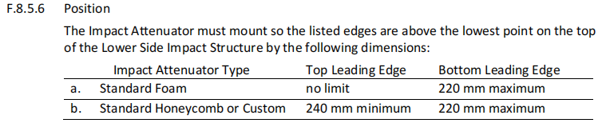
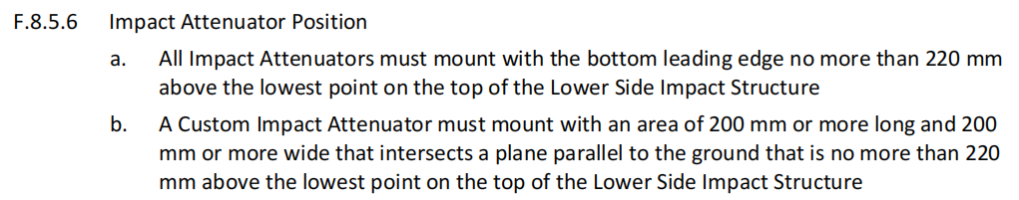
4. Technical Aspects——Body
4.21 Modified：IA Position（Ch2-3.23.10）
2023 FSCC Rules
2024 FSCC Rules

Slide 24
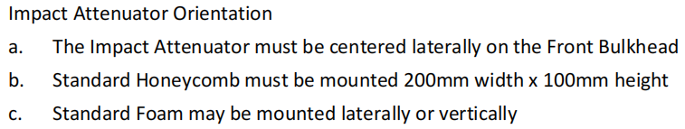
4. Technical Aspects——Body
4.22 Add：IA Orientation

Slide 25
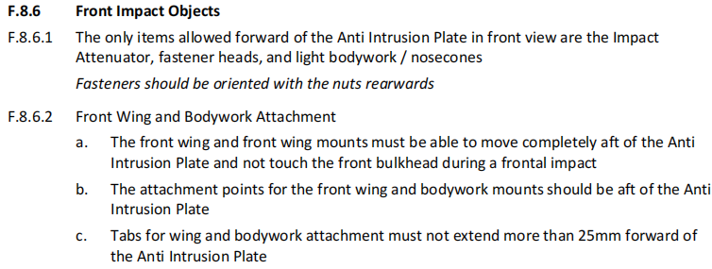
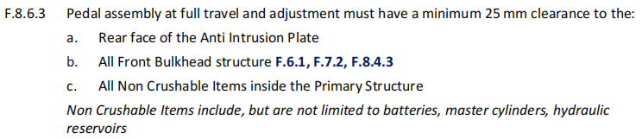
4. Technical Aspects——Body
4.23 Add：Front Impact Objects

Slide 26
4. Technical Aspects——Body
4.24 Modified：Tubes of driver’s seat requirement（Ch2-4.3）
2023 FSCC Rules
The Driver’s Seat must be protected by one of the following:
a. In side view, the lowest point of any Driver’s Seat must be no lower than the upper surface of the lowest structural tube.
b. A longitudinal tube (or tubes) that meets the requirements for Side Impact tubing (F.3.2.1.e), passing underneath the lowest point of the Driver Seat.
2024 FSCC Rules
The Driver’s Seat must be protected by one of the following:
a. In side view, the lowest point of any Driver’s Seat must be no lower than the upper surface of the lowest structural tube or equivalent.
b. A longitudinal tube (or tubes) that meets the requirements for Side Impact tubing (F.3.2.1.e), passing underneath the lowest point of the Driver Seat.

Slide 27
4. Technical Aspects——Body
4.25 Modified：Tab or bracket of the Harness
2023 FSCC Rules
Each tab or bracket to which any part of the Harness is attached must have a minimum cross sectional area of 60 mm2 of steel to be sheared or failed in tension at any point of the tab.
2024 FSCC Rules
Each tab or bracket to which any part of the Harness is attached must support a minimum load in pullout and tearout before failure of:
• If one belt is attached to the tab or bracket 15 kN
• If two belts are attached to the tab or bracket 30 kN
Where Lap Belts and Anti-Submarine Belts use the same attachment point, there must
be a minimum cross sectional area of 90 mm2 of steel to be sheared or failed in tension
at any point of the tab.

Slide 28
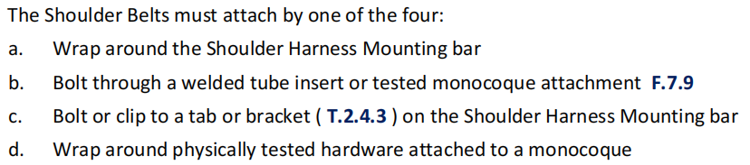
4. Technical Aspects——Body
4.26 Add：Shoulder Belts attachment

Slide 29
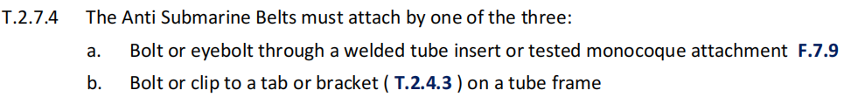
4. Technical Aspects——Body
4.27 Add：Anti Submarine Belts attachment
4.28 Add：Aerodynamic Device restriction
Any part of any Aerodynamic Device or Bodywork must meet Ch2-2.1 and Ch2-6.2.
4.29 Add：IA test restriction
Equivalent (higher) test velocities are only allowed to accommodate for a lower total testing mass, as long as the energy absorbed is 7350 J or more. If these requirements cannot be met, a team must use the standard IA.

Slide 30
4. Technical Aspects——Body
4.30 Add：SIS requirement
The distance to the ground below the Lower Side Impact Structure (Ch2-3.27.4&Ch2-3.36.1) at its lowest point should be 75 mm or less.
4.31 Add：Definition of Bodywork
Bodywork – the outermost surface of the chassis or any fairing parts and covers.
4.32 Add：Bodywork restriction
In any side view in front of the cockpit opening and outside the area defined in Ch2-9 all parts of the bodywork must have no external concave radii of curvatures. Any gaps between bodywork and other parts must be reduced to a minimum.

Slide 31
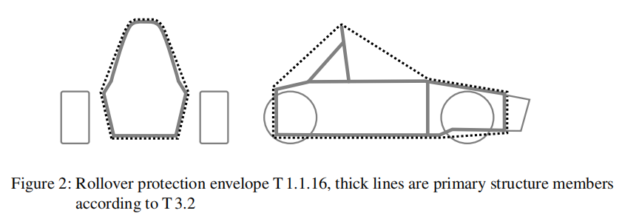
4. Technical Aspects——Body
4.33 Modified：Statement of Rollover protection envelope（Ch2-3.3）
2023 FSCC Rules
Rollover protection envelope – Envelope of the primary structure and any additional structuresfixed to the primary structure which meet the minimum specification or equivalent.
2024 FSCC Rules
Rollover protection envelope – the union of
• the primary structure and any additional structures fixed to the primary structure whichmeet the minimum specification or equivalent
• the plane from the top of the main hoop to the top of the front hoop
• the plane from the top of the main hoop to the rearmost structure orequivalent

Slide 32
4. Technical Aspects——Body
4.34 Add：asymmetrical lay-up requirement
If an asymmetrical lay-up is used in the primary structure, the thinner skin must have athickness of at least 40 % of the thicker skin.
4.35 Add：Other impact structures requirement
Other impact structures, see Ch4-1.4.2, Ch5-5.4.2, must be fully triangulated structures and consist of at least three steel tubes, see T3.2, on each side and rearward of the component that needs to be protected.
• If the component projects outwards from the roll hoops to the side, the front of the component must also be protected.
• The upper member must not be higher than 320 mm above the lowest inside chassis point between the front and main hoop.
4.36 Add：restriction of IA attachment
The IA may be attached to the AIP by a minimum of four 8 mm metric grade 8.8 bolts that are considered critical fasteners. Attachment(s) using adhesive must be able to carry a load of 60 kN in any direction

Slide 33
4. Technical Aspects——Body
4.37 Modified：Shoulder harness bar bracing in SES（Ch2-5.4.4）
2023 FSCC Rules
The strength of any shoulder harness bar bracing tubes must be proven in the relevant
tab of the team’s SES submission.
2024 FSCC Rules
The strength of any shoulder harness bar and bracing tubes must be proven in the relevant
tab of the team’s SES submission.
4.38 Modified：Jacks in lifted position（Ch2-6.7.2）
2023 FSCC Rules
In lifted position, the device(s) must not extend out of the area defined by the footprint of the four tires.
2024 FSCC Rules
In lifted position, the device(s) must not extend out of the vehicles projected surface area.

Slide 34
4. Technical Aspects——Chassis
4.39 Modified：ground clearance with active suspension system（Ch2-6.2.1）
2023 FSCC Rules
The minimum static ground clearance of any portion of the vehicle, other than the tires, including a driver, must be 30 mm.
2024 FSCC Rules
The minimum static ground clearance of any portion of the vehicle, other than the tires, including a driver, must be 30 mm. If an active suspension system is installed, the static ground clearance is measured in the lowest adjustable position.

Slide 35
4. Technical Aspects——Chassis
4.40 Modified：steering rack requirement（Ch2-6.5.4）
2023 FSCC Rules
The steering rack must be mechanically attached to the primary structure.
2024 FSCC Rules
The steering rack must be mechanically attached to the primary structure and all stationary
parts must be within the rollover protection envelope.
4.41 Modified：Break pedal material（Ch2-7.1.8）
2023 FSCC Rules
The brake pedal must be fabricated from steel or aluminium or machined from steel, aluminium or titanium.
2024 FSCC Rules
The brake pedal, including pedal face, must be fabricated from steel or aluminium or machined from steel, aluminium or titanium.

Slide 36
4. Technical Aspects——Chassis
4.42 Modified：BOTS requirement（Ch2-7.3.3）
2023 FSCC Rules
The brake over travel-switch must be a mechanical single pole, single throw switch, commonly known as a two-position switch, push-pull or flip type, it may consist of a series connection of switches.
2024 FSCC Rules
The BOTS must be a push-pull, push-rotate or flip type mechanical switch. It may consist of a series connection of switches.

Slide 37
4. Technical Aspects——Electronic
4.43 Add：System status light
Any system status light(s), see Ch2-7.4, must meet the following requirements:
• Black background.
• Rectangular, triangular or near round shape.
• Minimum illuminated surface of 15 cm2 with even luminous intensity.
• Clearly visible in very bright sunlight.
• If LED lights are used without a diffuser, they must not be more than 20 mm apart.
• If a single line of LED lights is used, the minimum length is 150 mm.

Slide 38
4. Technical Aspects——Chassis
4.44 Add：Break light requirement（Ch2-7.4）
The brake light must
be a red light.
be clearly visible from the rear.
meet requirements according to T11.10.(System status light)
In side view the brake light must be oriented vertically and mounted between the wheel centerline and driver’s shoulder level. Viewed from the back it must be positioned approximately at the vehicle’s centerline.

Slide 39
4. Technical Aspects——Powertrain
4.45 Add：final drivetrain shield requirement
The final drivetrain shield must:
a. Be made with solid material (not perforated)
b. Cover the chain or belt from the drive sprocket to the driven sprocket/chain wheel/belt
or pulley
c. Start and end no higher than parallel to the lowest point of the chain wheel/belt/pulley:
d. Cover the bottom of the chain or belt or rotating component when fuel, brake lines Ch2-7.1.6, control, pressurized, electrical components are located below.

Slide 40
4. Technical Aspects——Powertrain
4.46 Modified：Cylinder Material requirement（Ch2-10.1k）
2023 FSCC Rules
Cylinder Material – gas cylinders/tanks in a position 150 mm or less from an exhaust system
must be made from metal.
2024 FSCC Rules
Cylinder Material – gas cylinders/tanks in a position 150 mm or less from an exhaust system
must meet one of the two:
• Made from metal
• Meet the thermal protection requirements of Ch2-4.3.2

Slide 41
4. Technical Aspects——Powertrain
4.47 Modified：Fuel lines requirement（Ch4-2.7.3）
Fuel lines between fuel tank and fuel rail and return lines must:
• have reinforced rubber fuel lines with an abrasion protection with a fuel hose clamp which has a full 360◦ wrap, a nut and bolt system for tightening and rolled edges to prevent the clamp cutting into the hose, or
• have metal braided hoses with crimped-on or reusable, threaded fittings.
• be rated for temperatures of at least 120 ◦C.
• A barbed connector design if a hose & clamp style connection is used.

Slide 42
4. Technical Aspects——Electronic
4.48 Modified：LV Batteries attachment（Ch2-12.7）
FSAE_Rules_2023_V1 T9.2.1：
All Low Voltage Batteries and onboard power supplies must be attached securely to the Chassis.
FSAE_Rules_2024_V1 T9.2.1：
All Low Voltage Batteries and onboard power supplies must be securely mounted inside the Chassis below the height of the Shoulder Belt Mount Ch2-5.4

Slide 43
4. Technical Aspects——Electronic
4.49 Add：Shutdown buttons must be red
Shutdown buttons must be red.

Slide 44
5. Static Events
5.1 Add：
The quality of the actual prototype will not be considered as part of the Business Plan Presentation judging.
5.2 Modified：Penalty of Business Plan Presentation
If the business model presented does not relate to one of the areas listed within Ch7-5.1, 15 penaltypoints will be deducted from the team’s Business Plan Presentation scoring.
5.3 Add：
A self-manufactured “fastener” is considered a “part”.

Slide 45
6. Dynamic Events
6.1 Add：damaged fuel tank will not be refilled
For Internal Combustion vehicles (IC):
If damage or a potential environmental hazard (example - Fuel Tank leakage) exists, the Fuel Tank will not be refilled.
6.2 Add：（Ch7-8.22.3）
The vehicle that cannot measure fuel/energy used will receive zero points in efficiency.

Slide 46
6. Dynamic Events
6.3 Add：Re-Runs
A re-run may be granted in following cases:
• Usage of YELLOW FLAG in Autocross.
• Usage of RED FLAG.
• Usage of RES to ensure safe conditions on the track or traceable signal loss of the RES.
• After official’s decision due to technical or organizational issues.
The team will be informed about a granted re-run either by a sign at the exit or by direct communication through an official.
It is at the discretion of the team whether or not they accept the re-run. If the re-run is accepted, it must be executed immediately and the corresponding initial run is deleted.

Slide 47
6. Dynamic Events
6.4 Add：
A team may be disqualified if their vehicle is too slow or being driven without proper control. A vehicle is considered to be too slow if the average speed, based on lap times, for two consecutive laps is below 8 m/s in dry conditions or below 5 m/s in wet or damp conditions.

Slide 48
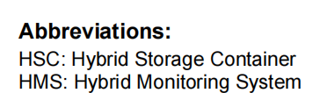
7. Hybrid System
7.0

Slide 49
7. Hybrid System
7.1 Eligibility
1.1 The Hybrid class is an extension of the CV class.
1.2 Hybrid vehicles will compete against / together with “regular” CV cars.
1.3 Unmodified FS-CV Vehicles are still eligible to run under FS hybrid rules.

Slide 50
7. Hybrid System
7.2 Definitions
2.1 The hybrid system must be a low voltage system, Ch2-12 is applied for all system components.
2.2. If there is a conflict between Ch2-12 and the hybrid rules, the hybrid rules apply.
2.3. Energy must be stored only in purely electrical energy storage systems such as batteries or supercapacitors. Other solutions, such as flywheels or compressed air energy storage are prohibited.
2.4. The HSC is defined as the energy storage system as per 2.3 (including the AIR and overcurrent protection) that can be used to introduce energy into the powertrain.
2.5. Exception from Rule Ch2-12.1.3: The maximum permitted voltage for motor controller/inverters internal low power control signals is 75 VDC.

Slide 51
7. Hybrid System
7.3 Additional technical rules
3.1 A firewall must be present between the low voltage battery and the fuel tank.
3.2. Hybrid cars have to be identified by an additional marking next to all three vehicle numbers with the capital letters “HY” in Roman Sans-Serif characters at least 75 mm high in white on a red background.
3.3. Hybrid components other than the LV battery must be positioned in the surface envelope see Ch2-3.3.
3.4. Rule Ch2-7.11 applies to hybrid vehicles as well.
3.5. Rule Ch2-8.1 applies to hybrid components as well.
3.6. The high current path of the hybrid system must meet Ch5-5.5.15.

Slide 52
7. Hybrid System
7.4 Additional CV rules
4.1. The entirety of the CV - rules from the 2024 FSCC Rules apply.
4.2. The hybrid system will be incorporated into the CV shutdown circuit.
4.3. The HSC AIR must be part of the shutdown circuit in such a way that one side of the relay coil is directly incorporated into the shutdown circuit and the other side is supplied by the hybrid control system.
4.4. Precharge circuits are allowed.
4.5. Ch5-2.1 applies also for hybrid vehicles.
4.6. The hybrid system may only be deployed if the combustion engine is runningor when the starter button is pushed.

Slide 53
7. Hybrid System
7.5 Energy Storage Container
5.1. The HSC must comply with Ch2-12.7 rules.
5.2. The HSC must comply with Ch2-12.7.8 regardless of chemistry type.
5.3. The disconnection mechanism must be designed as an AIR internal to the HSC, disconnecting the positive pole of the HSC. The AIR must be compliant with Ch5-6.6.3 - solid state relays are not allowed.
5.4. The maximum weight of the active material within the HSC is 3 kg.
5.5. If multiple HSCs are used, the total weight of the contained active material is limited to 3 kg.
5.6. The HSC must be removable to be inspected at scrutineering.
5.7. All electrical parts of the hybrid system must be IPxxB compliant when energized.
5.8. Moving energy into the HSC from a different electrical storage system is prohibited.
5.9. The HSC must be attached to the primary structure, see Ch2-3.3, and meet Ch5-6.5.9.

Slide 54
7. Hybrid System
7.6 Technical Documentation
6.1. The team has to submit a HSF, which contains the
■ Hybrid system wiring diagram;
■ Energy storage electrical and mechanical configuration;
■ Used electrical actuators placement and mechanical drawings, power and rpm limits.
6.2. The HSF is subject to approval. The deadline is the same as for the ESF documents of the respective competitions.

Slide 55
7. Hybrid System
7.7 Additional inspection rules
7.1. Hybrid cars will follow the respective applicable CV procedure.
7.2. Hybrid cars will have an additional HSC and HSD inspection during the CV scrutineering procedure.
7.3. It must be possible to easily determine the weight of the active material within the HSC during inspection. For example: one battery cell has to be provided for weighing and it must be possible to determine the number of cells in the HSC.

Slide 56
The Rules of Electrical Vehicle(FSEC) are fully based on FS Rules v1.1, and teams can directly refer to FS Rules EV (Page.82-99).
The link of FS Rules: https://www.formulastudent.de/fsg/rules/

Slide 57
Changes in 2024
FSAC Rules

Slide 58
Catalog
Administrative Regulations
General Technical Requirements
Technical Inspections
Dynamic Events

Slide 59
1.Administrative Regulations
1.1 Add：Limits on the total number of ESO and ASR
The sum of registered ASRs and ESOs must not exceed four persons.

Slide 60
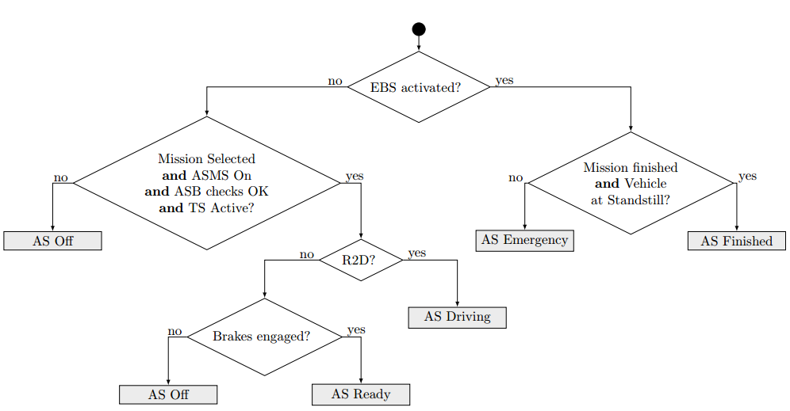
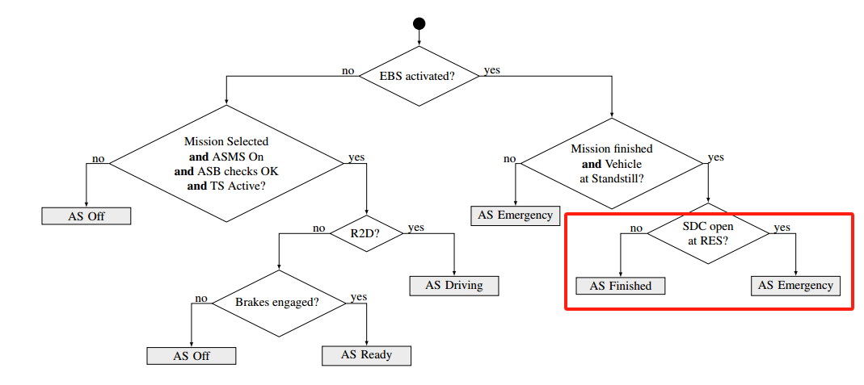
2.General Technical Requirements
2.1 Add：Added conditions to enter the AS Finished
The status of the AS must be determined according to the flowchart on the right.

Slide 61
2.General Technical Requirements
2.2 Add：ASSI visibility requirements
At least one ASSI must be visible from any angle of the vehicle from a point 1.60 m vertically from ground level, within 3 m horizontal radius from the top of the main hoop.
2.3 Add：Requirements for task selection
It must be possible to select any mission without the use of an external device.

Slide 62
2.General Technical Requirements
2.4 Add：Location requirements for ASB components
All parts of the ASB must be located within the rollover protection envelope, see T1.1.16.
2.5 Modified：ESB deceleration requirements
2023 FSAC Rules
The average deceleration must be greater than 8 m/s2 under dry track conditions.
2024 FSAC Rules
The average deceleration must be greater than 10 m/s2 under dry track conditions.

Slide 63
3.Technical Inspections
3.1 Add：Allows installation and removal of the sensor protective cover
After technical inspection, the only modifications permitted to the vehicle are:
- Installing and removing protective sensor covers, if approved during technical inspection.
3.2 Modified：Maximum safety distance of brake test
2023 FSAC Rules
During the brake test, the vehicle must accelerate in autonomous mode up to at least 40 km/h within 20 m. From the point where the RES is triggered, the vehicle must come to a safe stop within a maximum distance of 10 m.
2024 FSAC Rules
During the brake test, the vehicle must accelerate in autonomous mode up to at least 40 km/h within 20 m. From the point where the RES is triggered, the vehicle must come to a safe stop within a maximum distance of 8.5 m.

Slide 64
4.Dynamic Eventss
4.1 Add：The requirement to re-run due to loss of RES signal
If a traceable signal loss of the RES appears and doubtless proof can be brought by the team that it is was not self-inflicted, a re-run may be granted for the respective autonomous run, if the officials are notified before the affected dynamic event closes. The data logger data must be uploaded before notifying the officials.
4.2 Add：The requirement to re-run
A re-run may be granted in following cases:
  - Usage of YELLOW FLAG in Autocross.
  - Usage of RED FLAG.
  - Usage of RES to ensure safe conditions on the track or traceable signal loss of the RES according to D2.7.
  - After official’s decision due to technical or organizational issues

Slide 65
4.Dynamic Eventss
4.3 Del：Limits for unlabeled cones
The acceleration track is a straight line with a length of 75 m from starting line to finish line. The track is at least 3 m wide. Cones are placed along the track at intervals of about 5 m.Cone locations are not marked on the pavement.
4.4 Add：Maximum time to enter AS Finished
An Unsafe Stop (USS) is defined as not stopping within the specified area and/or not entering the finish-state described in T14.9 within 30 s after stopping during autonomous running.

Slide 66
The End

